Slide 1
The Basics
Of a window application

Slide 2
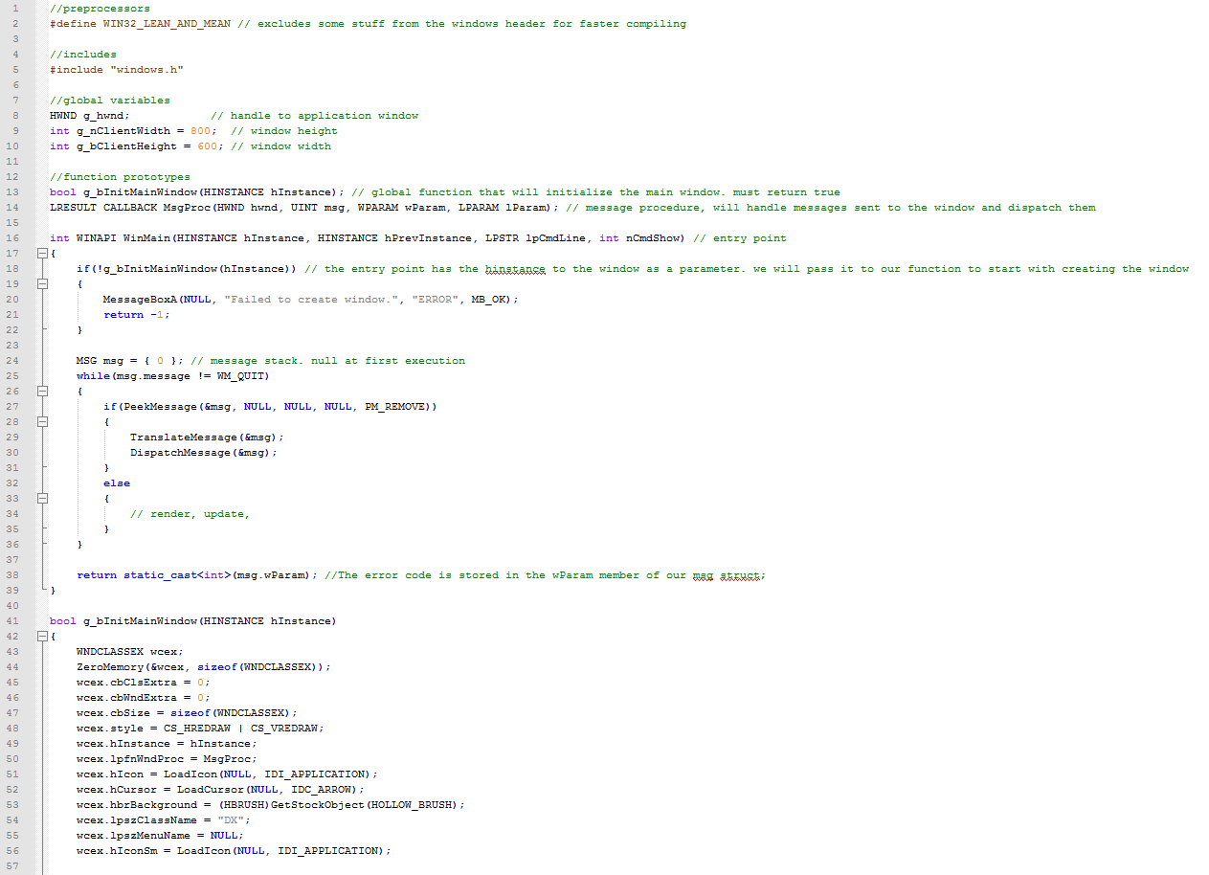
The basics are complicated.
It has taken me

Slide 3
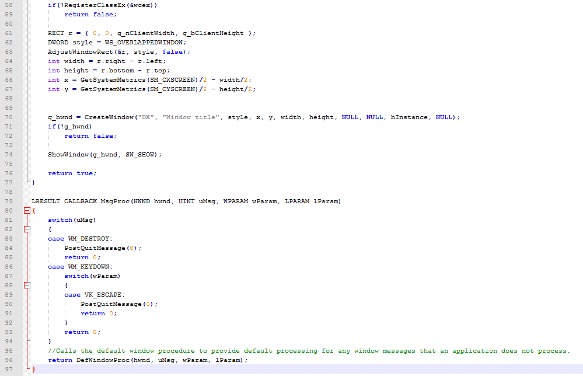

Slide 4
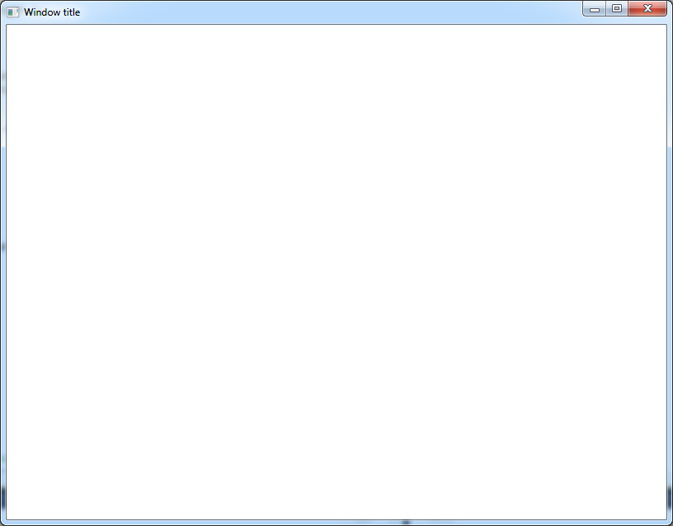
The product ? this:

Slide 5
Hmmm…
Okay, so that was 97 lines of (basic?!) C++ code to produce a simple white window.
Let’s take a closer look at the code.

